Slide 1
Stack & Queue
Chapter 4

Slide 2
Objectives
Stacks
Array-based stack
Stack implemented by a singly linked list
Stack class in java.util
Queues
Priority Queues
Queue interface in java.util
Reading at home

Slide 3
Stack

Slide 4
What is a stack?
A linear data structure
Can be accessed only at one of its ends for storing and retrieving data
A stack is a Last In, First Out (LIFO) data structure
Anything added will go to the top
Anything removed will be taken from the top
Things are removed in the reverse order that they were inserted

Slide 5
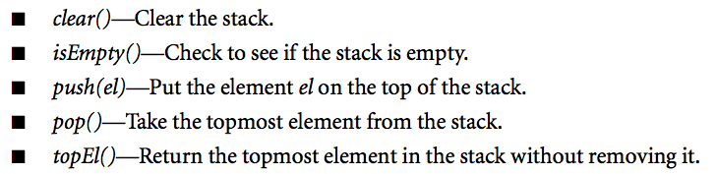
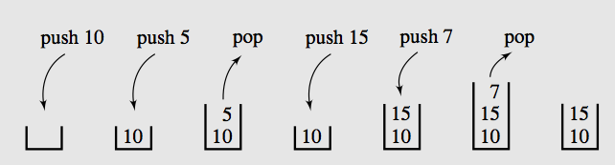
Operations on stack

Slide 6
Stack class in Java
Stack class implemented in java.util package is an extension of class Vector to which one constructor and five method are added.
Method | Operation
boolean empty() | Returns true if the stack includes no element and false otherwise
Object peek() | Returns top element on the stack; throw EmptyStackException for empty stack.
Object pop() | Remove the top element of the stack and return it; throw EmptyStackException for empty stack.
Object push(Object el) | Inserts el at the top of the stack and return it.
int search(Object el) | Returns the position of el on the stack (the first position is at the top; -1 in case of failure).
Stack() | Creates an empty stack

Slide 7
Examples
Folder Recursive listing
Connected Component counting
Flood filling
Well-formed expression testing
{{{}([]())}[]}
Mine sweeper
Distance transform

Slide 8
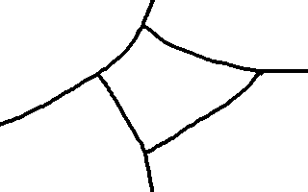

Flood filling
3
3
2
3
3
2
1
2
3
3
2
3
3

Slide 9
Flood fill with many region with many colors
GUI: Using mouse and color to select (google: swing JFrame)

Slide 10

Distance transform

Slide 11
Applications of stacks
Any sort of nesting (such as parentheses)
Evaluating arithmetic expressions (and other sorts of expression)
Implementing function or method calls
Keeping track of previous choices (as in backtracking)
Keeping track of choices yet to be made (as in creating a maze)
Undo sequence in a text editor
Auxiliary data structure for algorithms
Component of other data structure

Slide 12
Stack exceptions
Execution of an operation of ADT sometimes cause error condition, called an exception
An operation that cannot be executed will throw an exception.
In the Stack ADT, operations pop and top cannot be performed if the stack is empty
Attempting the execution of pop or top on an empty stack throws a StackEmptyException
Notes:
ADT: Abstract Data Type

Slide 13
Stack in computer memory
How does stack in memory actually work?
Each time a method is called, an activation record (AR, which is also called Stack frame) is allocated for it.
This record usually contains following information:
Parameters and local variables used in the called method
A pointer to the caller’s activation record.
Return address, the address of the caller’s instruction immediately following the call.
Return value for a method not declared as void.
Because activation record size varies for different method calls, the returned value is placed right above the activation record of the caller.

Slide 14
Stack in computer memory
Each new activation record is placed on the top of the run-time stack
When a method terminates, its activation record is removed from the top of the runtime stack
Thus, first AR placed on the stack is the last one removed.

Slide 15
Array based Implementation

Slide 16
Array-based stack
A simple way of implementing the Stack ADT uses an array
We add elements from left to right
A variable top keeps track of the index of the top element
…
S
 | 0 | 1 | 2 | 3 | 4 | 5 | 6 | 7 |  |  |  |  |  | top

Slide 17
Array-based stack
The array storing the stack elements may become full
A push operation will then throw a FullStackException
Limitation of the array-based implementation
Not intrinsic to the Stack ADT
…
S
 | 0 | 1 | 2 | 3 | 4 | 5 | 6 | 7 |  |  |  |  |  |  |  |  | top

Slide 18
Functionalities
Common characteristics
Object[] a
int top, max
Constructors
ArrayStack(int max)
ArrayStack() – default max=50
Common behaviors
isEmpty()
isFull()
clear()
grow()
push()
top()
pop()

Slide 19
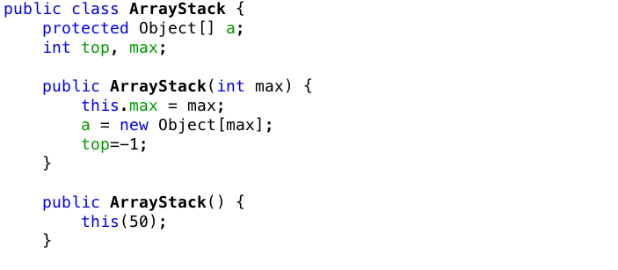
Array implementation of Stack

Slide 20
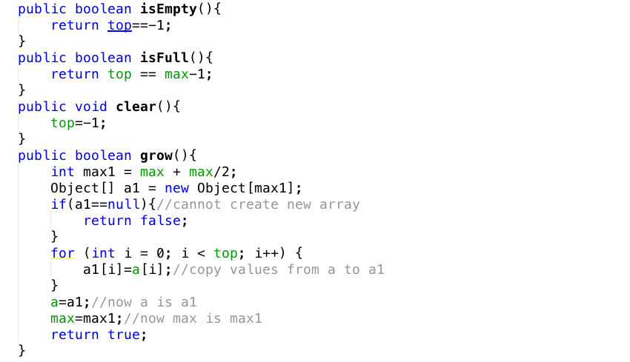
Array implementation of Stack

Slide 21
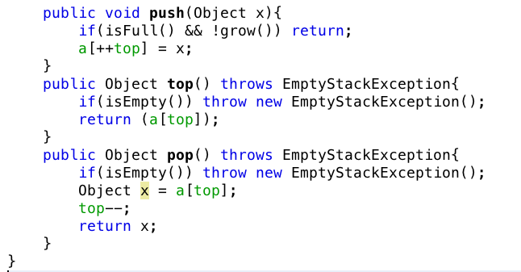
Array implementation of Stack

Slide 22
ArrayList based implementation

Slide 23
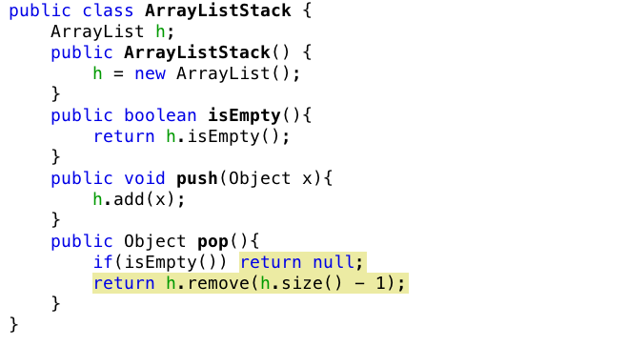
ArrayList Implementation of Stack

Slide 24
LinkedList Implementation of Stack

Slide 25
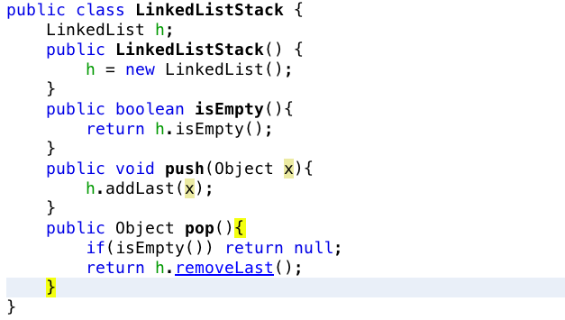
LinkedList implementation of Stack

Slide 26
Use of Stack – Convert 10 to binary
/2
/2
/2
/2
Stop
10
5
2
1
0
%2
%2
%2
%2
0
1
0
1
return
return
return
return
print
print
print
print
0
1
0
1
Values
2⁰
2¹
2²
2³

Slide 27
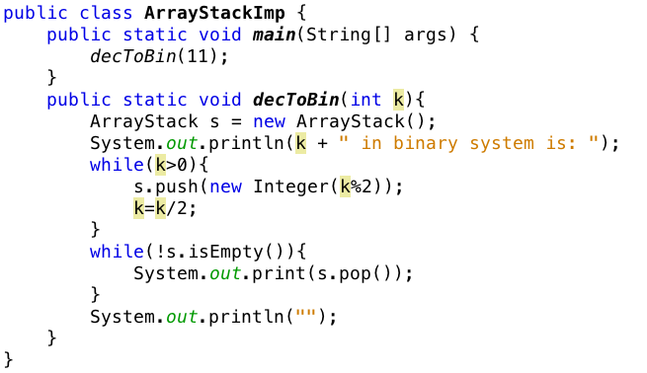
Example using stack

Slide 28
Queue

Slide 29
What is a queue?
Queue is a waiting line that grows by adding elements to its end and shrinks by taking elements from its front
A queue is a structure in which both ends are used
One for adding new elements
One for removing them
A queue is a FIFO structure: First In/First Out

Slide 30
Operations on a Queue
The following operations are needed to properly manage a queue:
clear(): clear the queue
isEmpty(): check to see if queue is empty
enqueue(el): put the element at the end of the queue
dequeue(): take the first element and remove it from the queue
front(): return first element without removing it (sometimes is named as peek()).

Slide 31
Queue in Java
Java does provide interface for Queue and an Implementation for Priority Queue in the java.util package
java.util.Queue;
java.util.PriorityQueue;

Slide 32
Exceptions
Attempting the execution of dequeue or front on an empty queue throws an EmptyQueueException

Slide 33
Queue example
Operation | Output | Queue
enqueue(5) | ___ | (5)
enqueue(3) | ___ | (5, 3)
dequeue() | 5 | (3)
enqueue(7) | ___ | (3, 7)
dequeue() | 3 | (7)
front() | 7 | (7)
dequeue() | 7 | ()
dequeue() | “error” | ()
isEmpty() | true | ()
enqueue(9) | ___ | (9)
enqueue(7) | ___ | (9, 7)
size() | 2

Slide 34
Application of Queues
Direct application
Waiting lists
Access to shared resources (e.g., printer)
Multiprogramming
Indirect applications
Auxiliary data structure for algorithms
Component of other data structures

Slide 35
Application: Round Robin Schedulers
Round-robin:
One of simplest scheduling algorithms for processes in OS
Assigns time slices process in equal portions and circular order
Handles all processes without priority.
It has properties:
Simple and easy to implement
Starvation-free
Applications to other problems
Data packet scheduling in computer networks.
Its name comes from round-robin principle
known from other fields
each person takes an equal share of something in turn.

Slide 36
Array based Implementation

Slide 37
Array-based Queue
Use an array of size N in a circular fashion
Two variables keep track of the first and the last
f index of the front element
l index of the last element
Normal configuration
Q
 | 0 | 1 | 2 | … | f |  |  |  | … |  |  |  |  | l
Wrapped-around configuration
Q
 | 0 | 1 | 2 | … | l |  |  |  | … |  |  | f

Slide 38
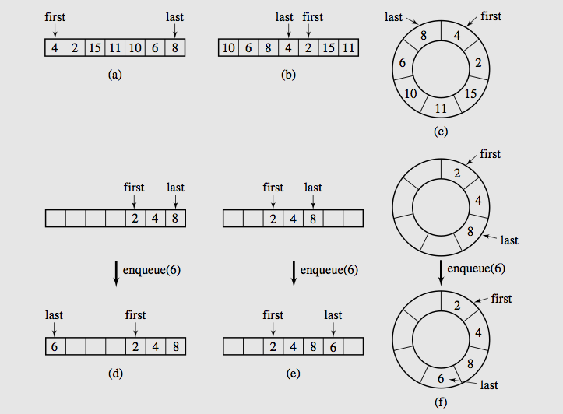
Array based Queue

Slide 39
isFull() cases
Case 1
max
first
last
Case 2
max
last
first
(Already wrapped back and catches first again)

Slide 40
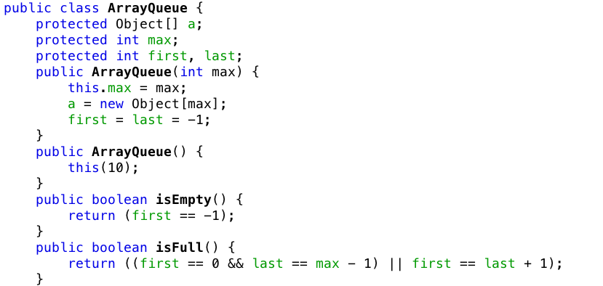
Array implementation of Queue

Slide 41
grow() cases
Case 1: first < last
i=
first
last
0 | 1 | 2 | 3 | 4 | 5 | 6 | 7 | 8 | 9
max
i-first
Size = last – first + 1
0 | 1 | 2 | 3 | 4 | 5 | 6 | 7 | 8 | 9 | 10 | …
Case 2: last < first
j=0
last
i=
first
max-1
0 | 1 | 2 | 3 | 4 | 5 | 6 | 7 | 8 | 9
max
Size = max– first + last
0 | 1 | 2 | 3 | 4 | 5 | 6 | 7 | 8 | 9 | 10 | …
i-first
j+max-first

Slide 42
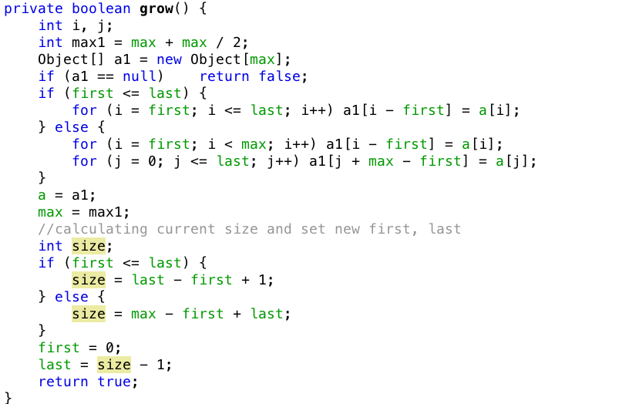
Array implementation of Queue
Mistake:
Need to + 1 here

Slide 43
enqueue() cases
Case 1: first or wrapped back
first
last
0 | 1 | 2 | 3 | 4 | 5 | 6 | 7 | 8 | 9
max
last
first
0 | 1 | 2 | 3 | 4 | 5 | 6 | 7 | 8 | 9
max
Case 2: Normal
last
first
0 | 1 | 2 | 3 | 4 | 5 | 6 | 7 | 8 | 9
max

Slide 44
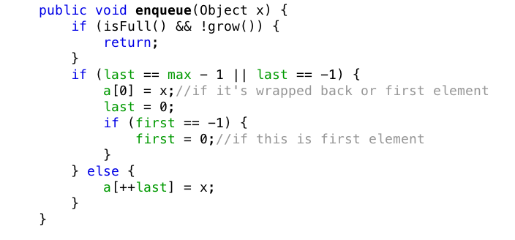
Array implementation of Queue

Slide 45
dequeue() cases
Case 1: only one element (first==last) then first=last=-1
first
last
0 | 1 | 2 | 3 | 4 | 5 | 6 | 7 | 8 | 9
max
Case 2: wrapped back (first==max-1) then first = 0
last
first
0 | 1 | 2 | 3 | 4 | 5 | 6 | 7 | 8 | 9
max
Case 3: otherwise, first++
first
last
0 | 1 | 2 | 3 | 4 | 5 | 6 | 7 | 8 | 9
max

Slide 46
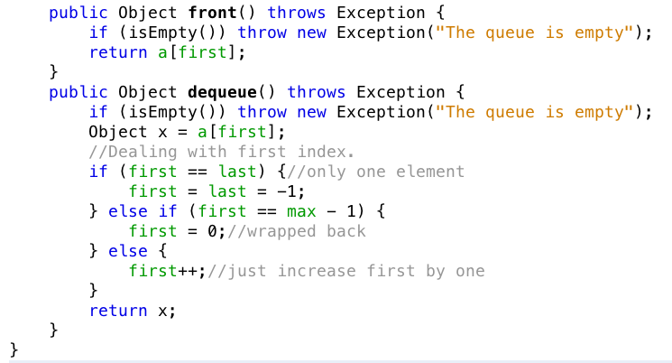
Array implementation of Queue

Slide 47
Linked Implementation of queue

Slide 48
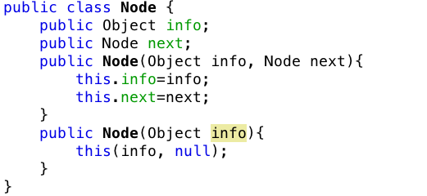
Linked Implementation of a queue

Slide 49
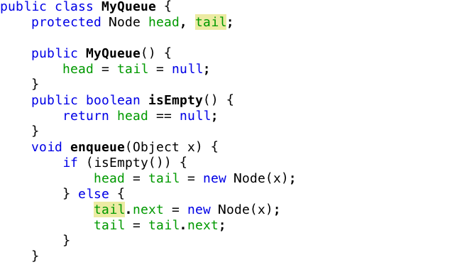
Linked Implementation of a queue

Slide 50
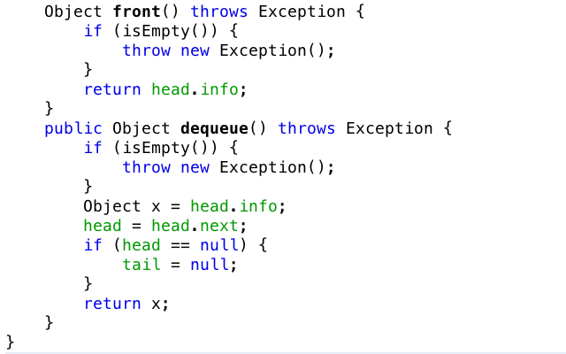
Linked Implementation of a queue

Slide 51
Priority
Queue

Slide 52
Queue in Java
Java does provide interface for Queue and an Implementation for Priority Queue in the java.util package
java.util.Queue;
java.util.PriorityQueue;

Slide 53
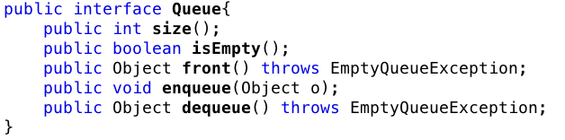
Queue Interface
Java interface corresponding to our Queue ADT
Requires the definition of class EmptyQueueException

Slide 54
Priority queue
Priority queue enables operations out of sequence without affecting overall system operation
FIFO rule is broken in these situations
Elements are de-queued according to their priority and their current queue position.

Slide 55
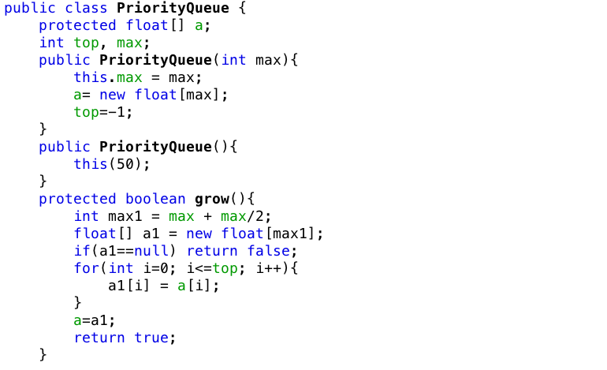
Priority queue implementation
Mistake:
Missing max=max1;

Slide 56
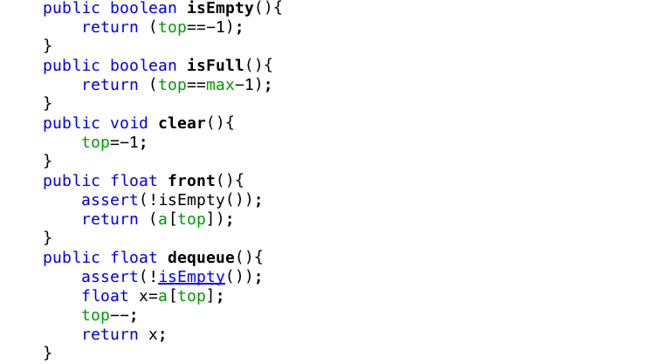
Priority queue implementation

Slide 57
Looking for the right position (priority)
Input order
23
17
45
18
12
22

Slide 58
Looking for the right position (priority)
Input order
23
17
45
18
12
22
1
2
3
4
5
6

Slide 59
Looking for the right position (priority)
Input order
23
17
45
18
12
22
1
2
3
4
5
6
Stored order
1
2
3
4
5
6

Slide 60
Looking for the right position (priority)
Input order
17
45
18
12
22
1
2
3
4
5
6
Stored order
23
1
2
3
4
5
6

Slide 61
Looking for the right position (priority)
Input order
45
18
12
22
1
2
3
4
5
6
Stored order
17
23
1
2
3
4
5
6

Slide 62
Looking for the right position (priority)
Input order
18
12
22
1
2
3
4
5
6
Stored order
17
23
45
1
2
3
4
5
6

Slide 63
Looking for the right position (priority)
Input order
12
22
1
2
3
4
5
6
Stored order
17
18
23
45
1
2
3
4
5
6

Slide 64
Looking for the right position (priority)
Input order
1
2
3
4
5
6
Stored order
12
17
18
22
23
45
1
2
3
4
5
6

Slide 65
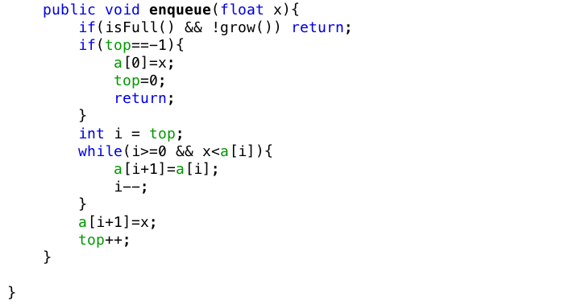
Priority queue implementation

Slide 66
Summaries
Stacks
Array-based stack
Stack implemented by a singly linked list
Stack class in java.util
Queues
Priority Queues
Queue interface in java.util
Reading at home

